Slide 1
DNA replication
DNA:
https://www.youtube.com/watch?v=o_-6JXLYS-k
DNA Replication:
https://www.youtube.com/watch?v=TNKWgcFPHqw

Slide 2

DNA stores information in the sequence of its bases
Much of DNA’s sequence-specific information is accessible only when the double helix is unwound
Proteins read the DNA sequence of nucleotides as the DNA helix unwinds.
Proteins can either bind to a DNA sequence, or initiate the copying of it.
Some genetic information is accessible even in intact, double-stranded DNA molecules
Some proteins recognize the base sequence of DNA without unwinding it (One example is a restriction enzyme).

Slide 3
DNA Replication
Process of duplication of the entire genome prior to cell division
Biological significance
extreme accuracy of DNA replication is necessary in order to preserve the integrity of the genome in successive generations
In eukaryotes , replication only occurs during the S phase of the cell cycle.
Replication rate in eukaryotes is slower resulting in a higher fidelity/accuracy of replication in eukaryotes

Slide 4
The mechanism of DNA replication
  Initiation
    Proteins bind to DNA and open up double helix
    Prepare DNA for complementary base pairing
  Elongation
    Proteins connect the correct sequences of nucleotides into a continuous new strand of DNA
  Termination
    Proteins release the replication complex

Slide 5
Basic rules of replication
Semi-conservative
Starts at the ‘origin’
Synthesis always in the 5-3’ direction
Can be uni or bidirectional
Semi-discontinuous
RNA primers required

Slide 6
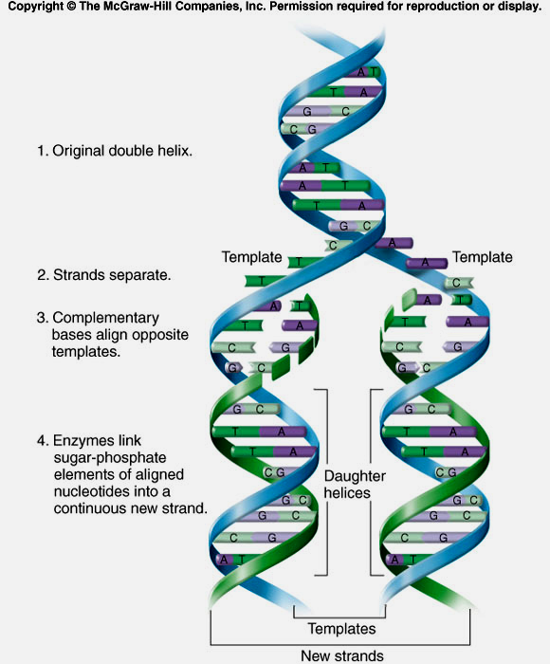
Semi-conservative replication:
One strand of duplex passed on unchanged to each of the daughter cells. This 'conserved' strand acts as a template for the synthesis of a new, complementary strand by the enzyme DNA polymerase
Notes:
Figure 6.16

Slide 7
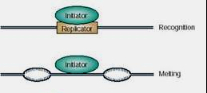
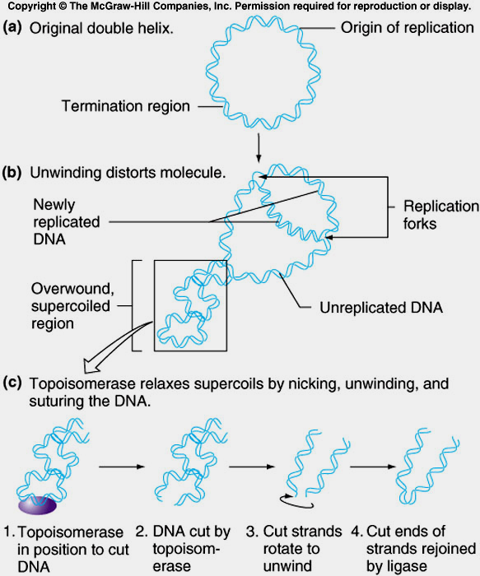
B) Starts at origin
Initiator proteins identify specific base sequences on DNA called sites of origin
Prokaryotes – single origin site E.g E.coli - oriC
Eukaryotes – multiple sites of origin (replicator)
E.g. yeast - ARS (autonomously replicating sequences)
Prokaryotes
Eukaryotes

Slide 8
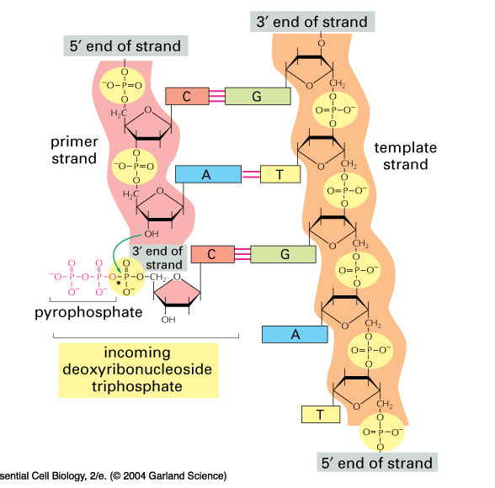
In what direction does DNA replication occur?
C) Synthesis is ALWAYS in the 5’-3’ direction
Notes:
06_02_DNA template.jpg

Slide 9
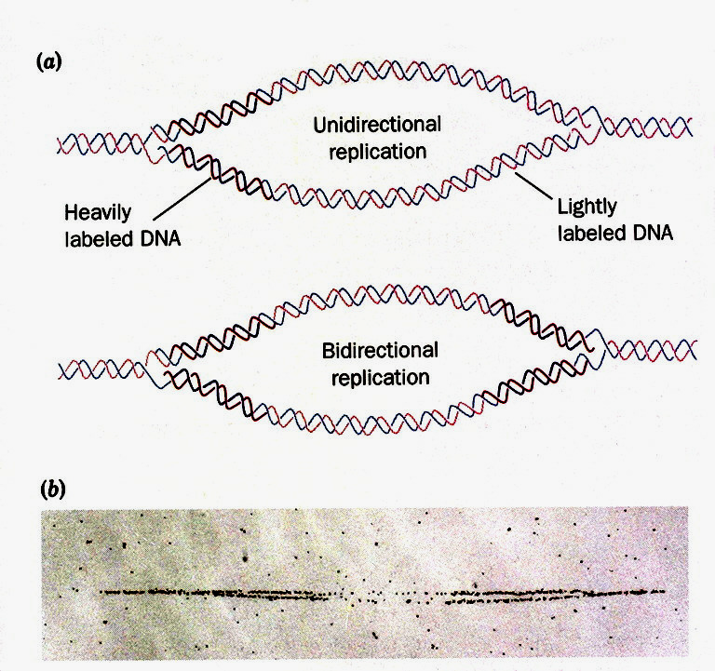
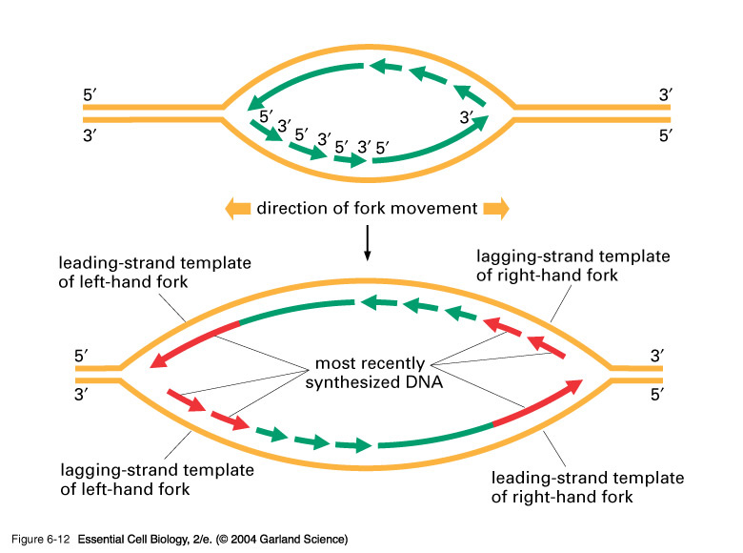
D) Uni or bidirectional
Replication forks move in one or opposite directions

Slide 10
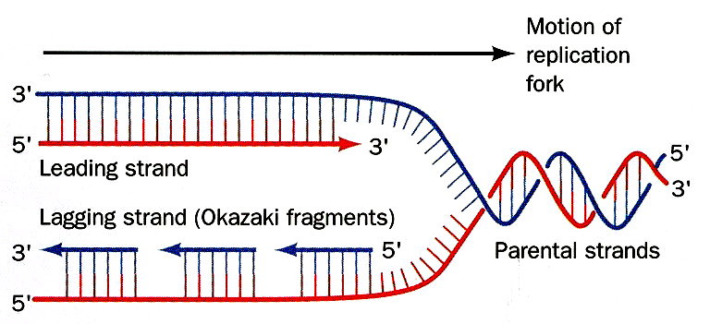
E) Semi-discontinuous replication
Anti parallel strands replicated simultaneously
Leading strand synthesis continuously in 5’– 3’
Lagging strand synthesis in fragments in 5’-3’

Slide 11
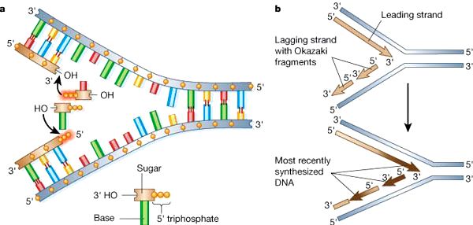
Semi-discontinuous replication
New strand synthesis always in the 5’-3’ direction

Slide 12
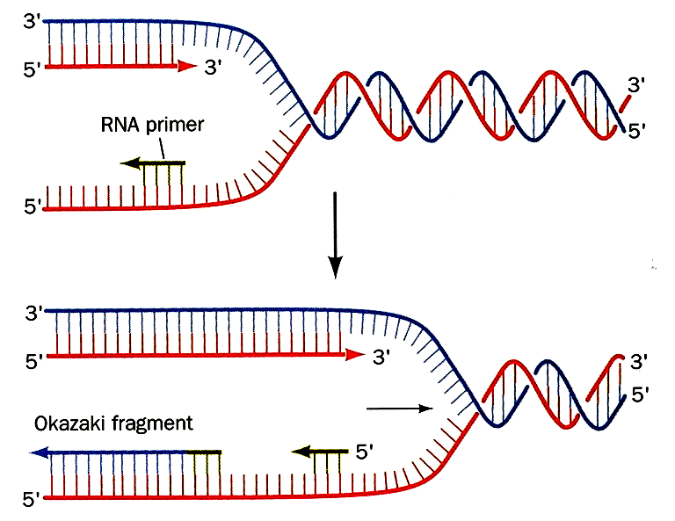
F) RNA primers required

Slide 13
Core proteins at the replication fork
Topoisomerases
Helicases
Primase
Single strand
binding proteins
DNA polymerase
Tethering protein
DNA ligase
- Prevents torsion by DNA breaks (Act to regulate DNA supercoiling by catalysing the winding and unwinding of DNA strands)
- separates 2 strands
- RNA primer synthesis
- prevent reannealing
of single strands
- synthesis of new strand
- stabilises polymerase
- seals nick via phosphodiester linkage

Slide 14
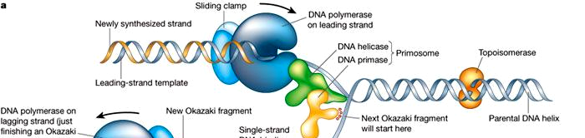
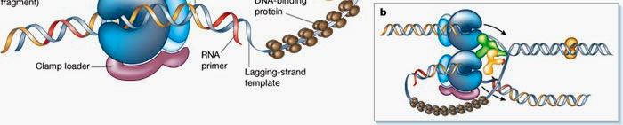
Core proteins at the replication fork
Nature (2003) vol 421,pp431-435
Figure in ‘Big’ Alberts too

Slide 15
What kind of enzyme synthesizes the new DNA strand?
Some simple questions
RNA polymerase
DNA Polymerase
Primase
Helicase
Topoisomerase

Slide 16
Eukaryotic chromosomes have multiple origins of replication
True
False

Slide 17
In what direction is the newly synthesized DNA produced?
5'-3'
3'-5'
In the direction of the major groove
Both 5'-3' and 3'-5' depending on which strand is being replicated

Slide 18
Nucleotides are always added to the growing DNA strand at the 3’ end, at which the DNA has a free ______ on the 3’ carbon of its terminal deoxyribose.
Phosphate group
Hydroxyl group
Nitrogen base
Methyl group

Slide 19
The E. coli chromosome has 4.7x10⁶ bp; a bi-directional replication fork progresses at about 1000 nucleotides/sec. Therefore, the minimum time required to complete replication is
12 min.
24 min.
39 min
78 min
120 min

Slide 20
What is the sequence (1 to 6) in which these proteins function during DNA replication
____ RNA primase
____ DNA ligase
____ DNA polymerase
____ Topoisomerase
____ DNA helicase
____ tethering proteins

Slide 21
Why is an RNA primer necessary for DNA replication?
The RNA primer is necessary for the activity of DNA ligase.
The RNA primer creates the 5’ and 3’ ends of the strand.
DNA polymerase can only add nucleotides to RNA molecules.
DNA polymerase can only add nucleotides to an existing strand

